Slide 1


Makerspace Equipment Rental Process
Group 35

Slide 2
Process Identification

Slide 3
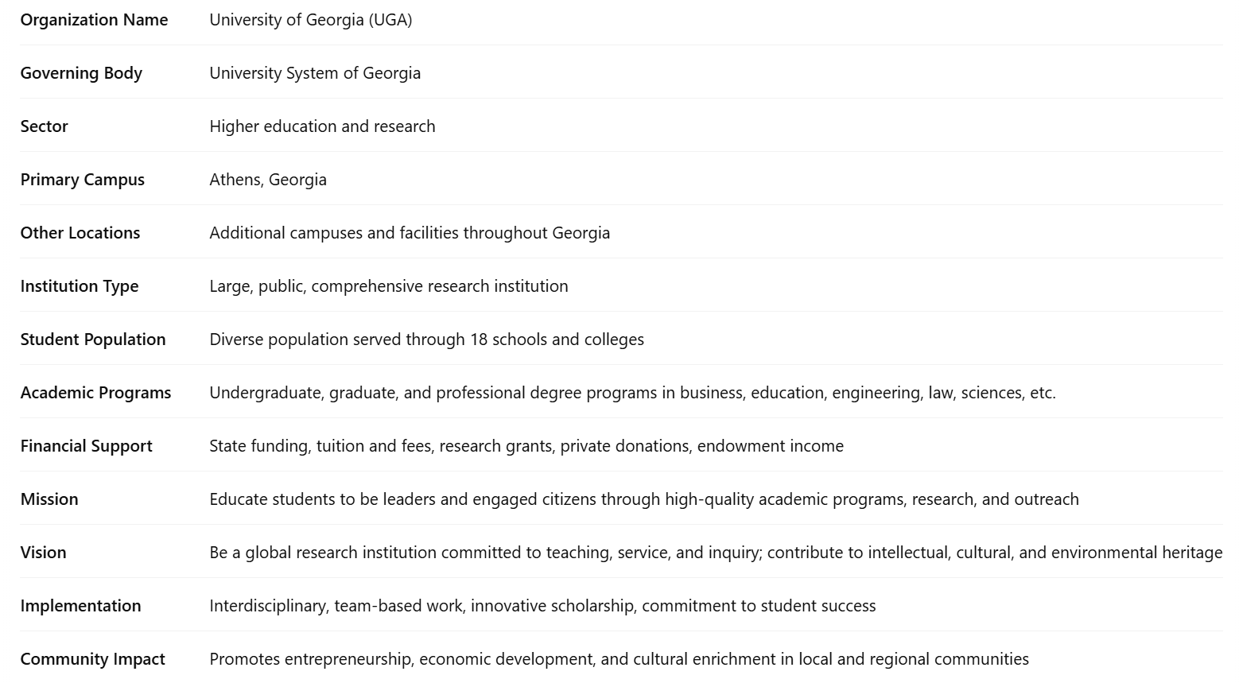
Business Description
Our selected business process is the equipment rental process through the Makerspace library which is run by the University of Georgia. The University of Georgia is part of the University System of Georgia, which governs the public institutions of higher education in Georgia. UGA operates in higher education and research. Our primary campus is located in Athens, Georgia, although there are additional campuses and facilities throughout the state. UGA is a large, public, comprehensive research institution that serves a diverse population of students and offers a broad range of undergraduate, graduate, and professional degree programs through 18 schools and colleges in areas such as business, education, engineering, law, and the sciences.
UGA receives financial support from multiple sources, including state funding, tuition and fees, research grants, private donations, and endowment income. The university’s mission is to educate students to be leaders and engaged citizens through high-quality academic programs, research, and outreach. UGA's vision is to be a global research institution committed to teaching, service, and inquiry, contributing to the state's and nation's intellectual, cultural, and environmental heritage. UGA realizes this vision through interdisciplinary, team-based work, innovative scholarship, and a commitment to student success, as well as its unique position in promoting entrepreneurship, economic development, and cultural enrichment in its local and regional communities.

Slide 4
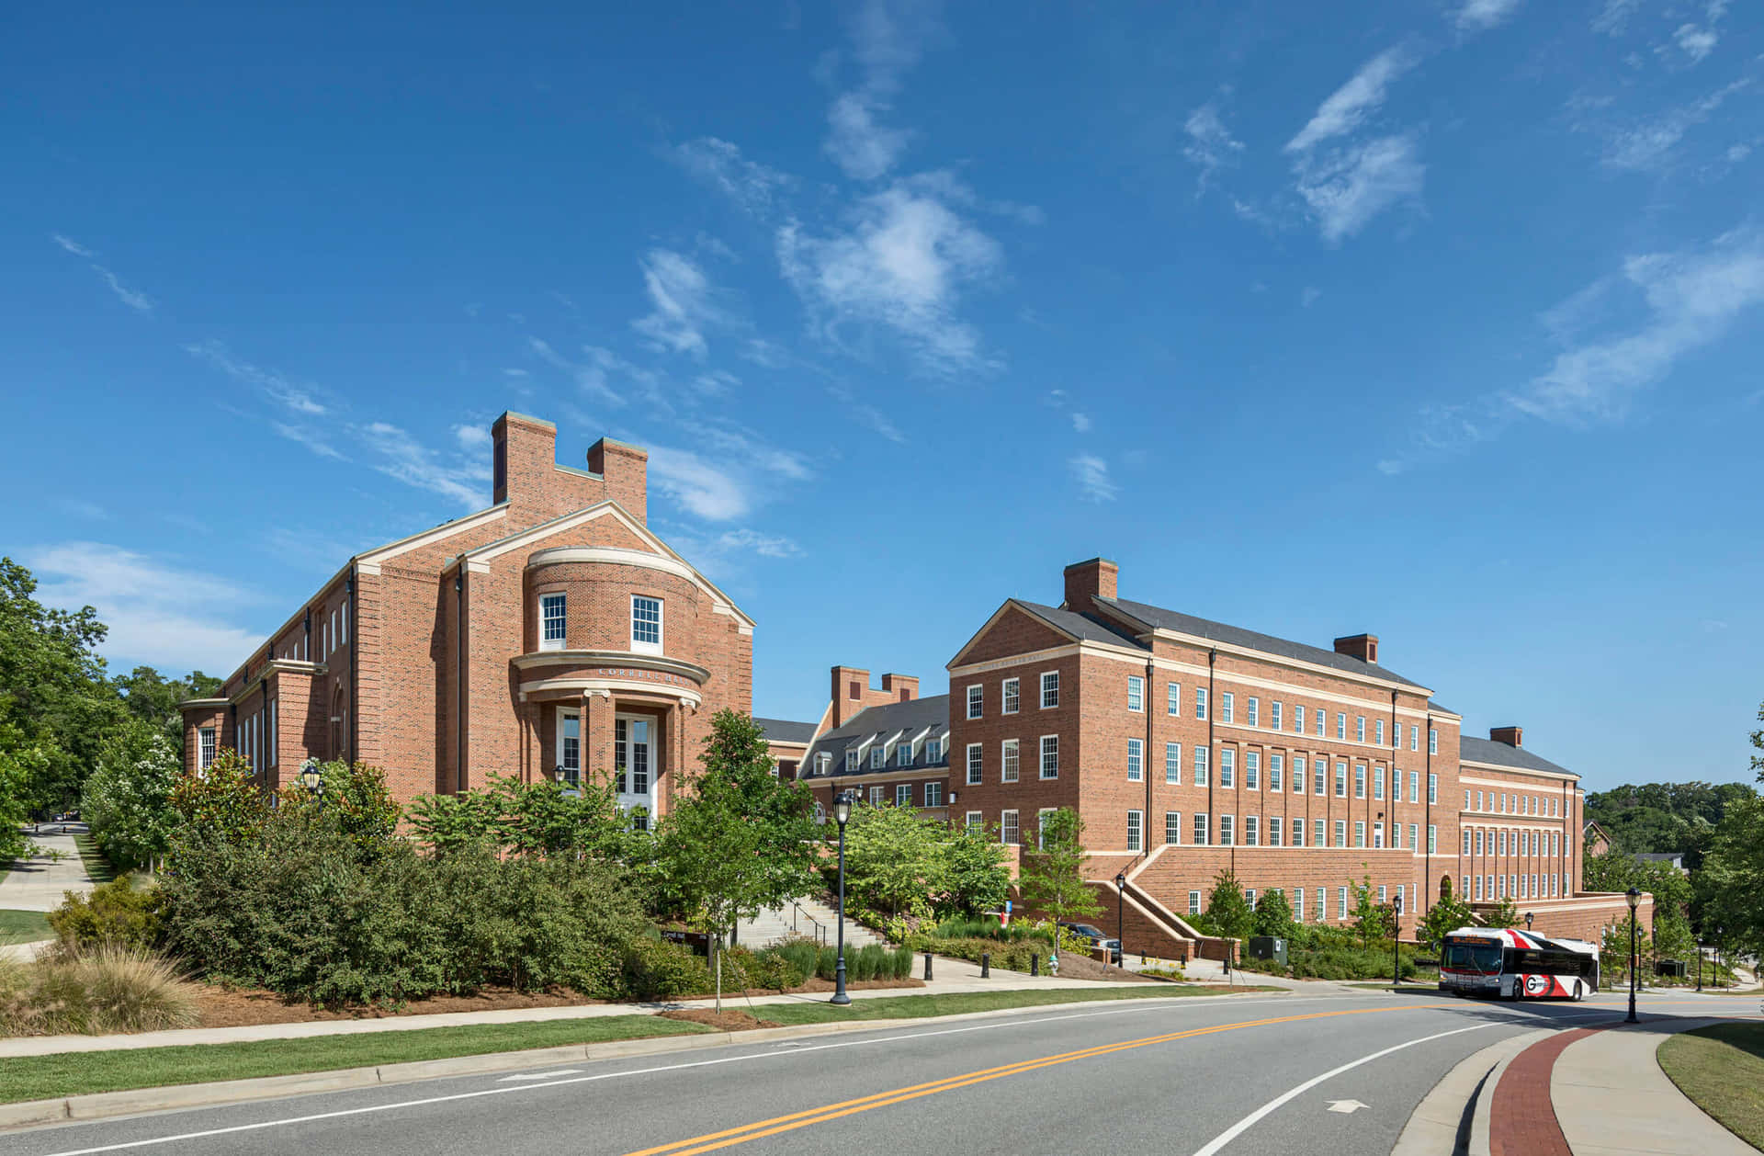
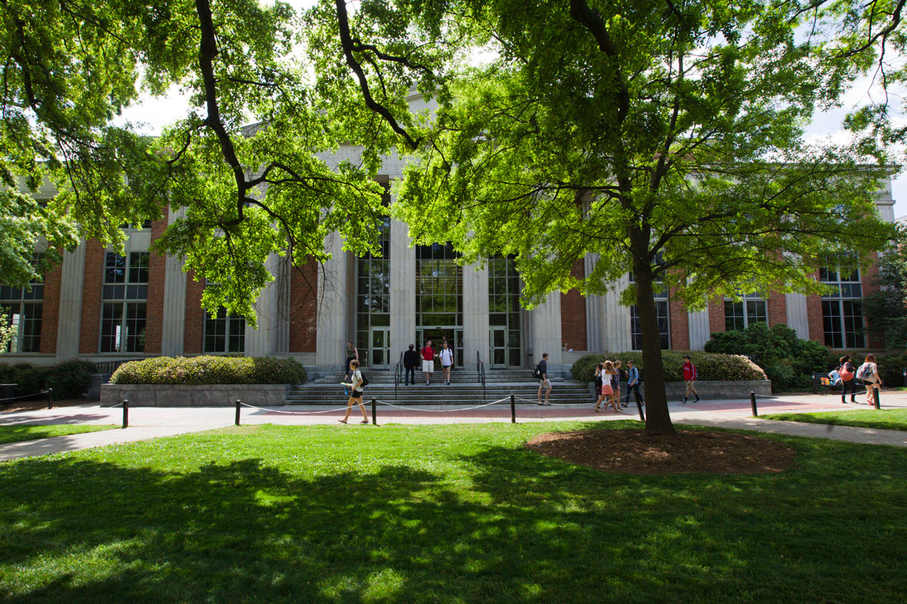
Business Description Photos
Photos of the University of Georgia

Slide 5
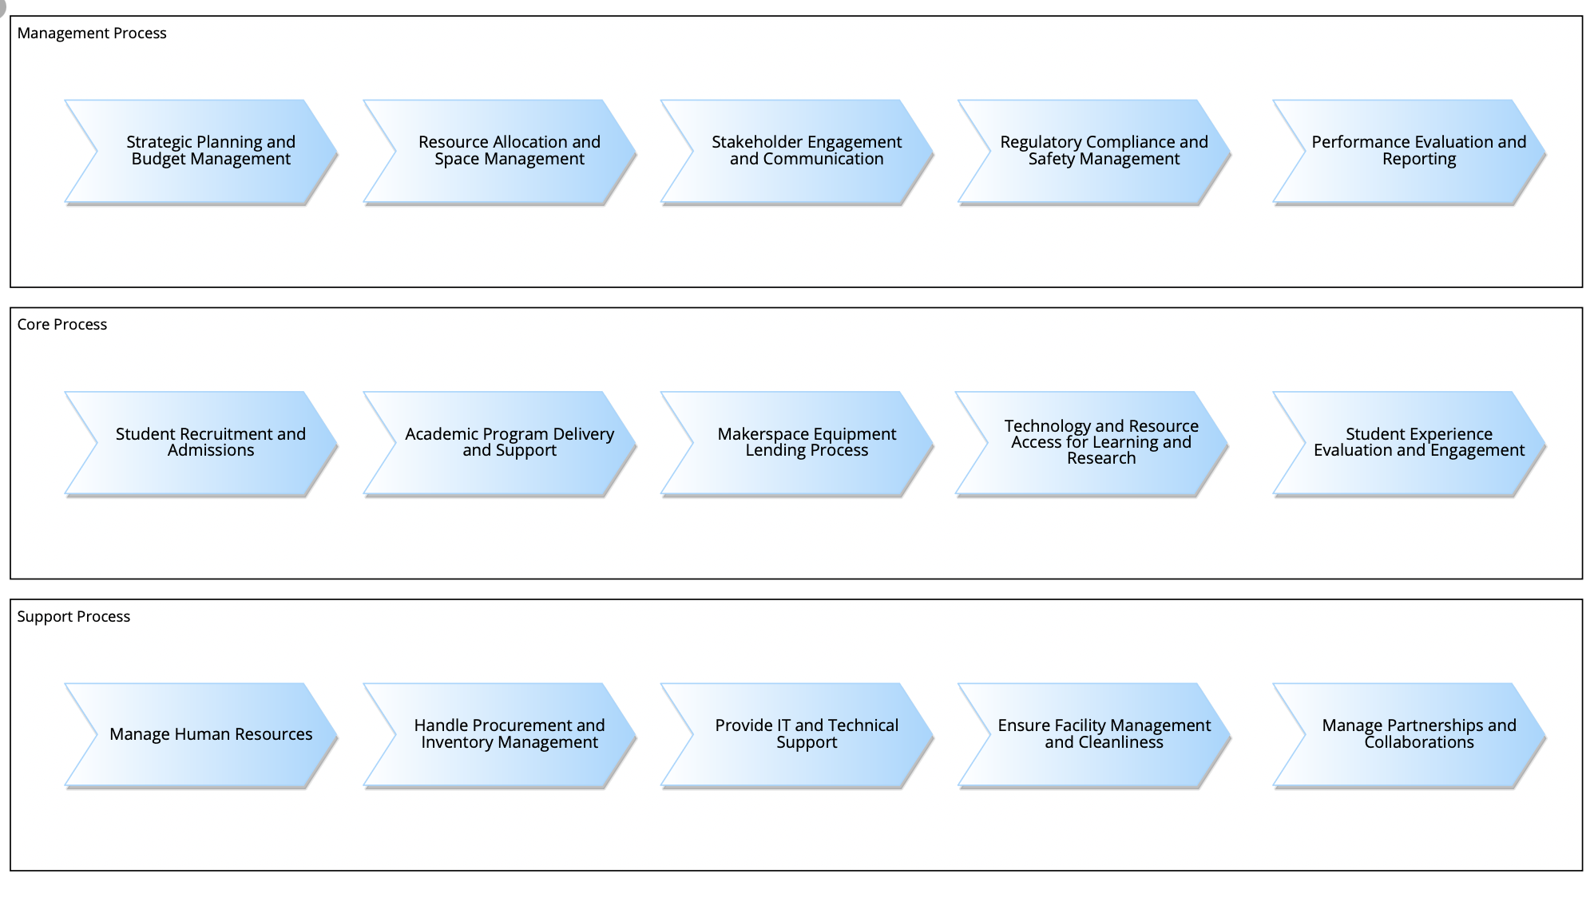
Value Chain Diagram

Slide 6
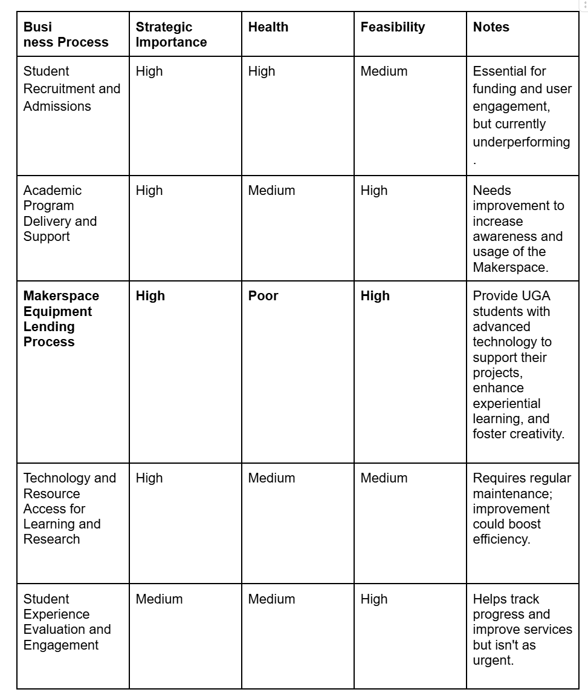
Process Portfolio Prioritization and Selection

Slide 7
Process Portfolio Prioritization and Selection
Why did we focus on the Makerspace Equipment Lending Process?
We chose to improve the Makerspace equipment lending process at UGA due to its high strategic importance, poor current state, and high feasibility for improvement. We believe this process is strategically important because it supports hands-on learning opportunities that students cannot easily access through traditional classroom lectures. The process is currently in poor health, as the required equipment training is lengthy and could be made more efficient. Finally, we believe there is high feasibility for improvement with redesign and can be easily implemented using UGA’s existing technology resources.

Slide 8
Process Discovery

Slide 9
Discovery Methods
Documents:
https://guides.libs.uga.edu/makerspace
https://www.libs.uga.edu/adminservices/security/conduct-policy
https://guides.libs.uga.edu/ld.php?content_id=76963557
https://guides.libs.uga.edu/ld.php?content_id=69895607
https://policy.uga.edu/_resources/documents/studentaffairs/Code-of-Conduct.pdf
Webpages:
Makerspace website
McBay Science Library Makerspace | UGA Libraries
Equipment Resource Guide
3D Printers - UGA Libraries Makerspace - Databases & Subject Guides at University of Georgia
Online Reviews:
https://maps.app.goo.gl/JU52Nn7h2AQ882Pw5
https://www.facebook.com/scilibmakerspace/reviews
https://www.facebook.com/ugasciencelibrary/reviews

Slide 10
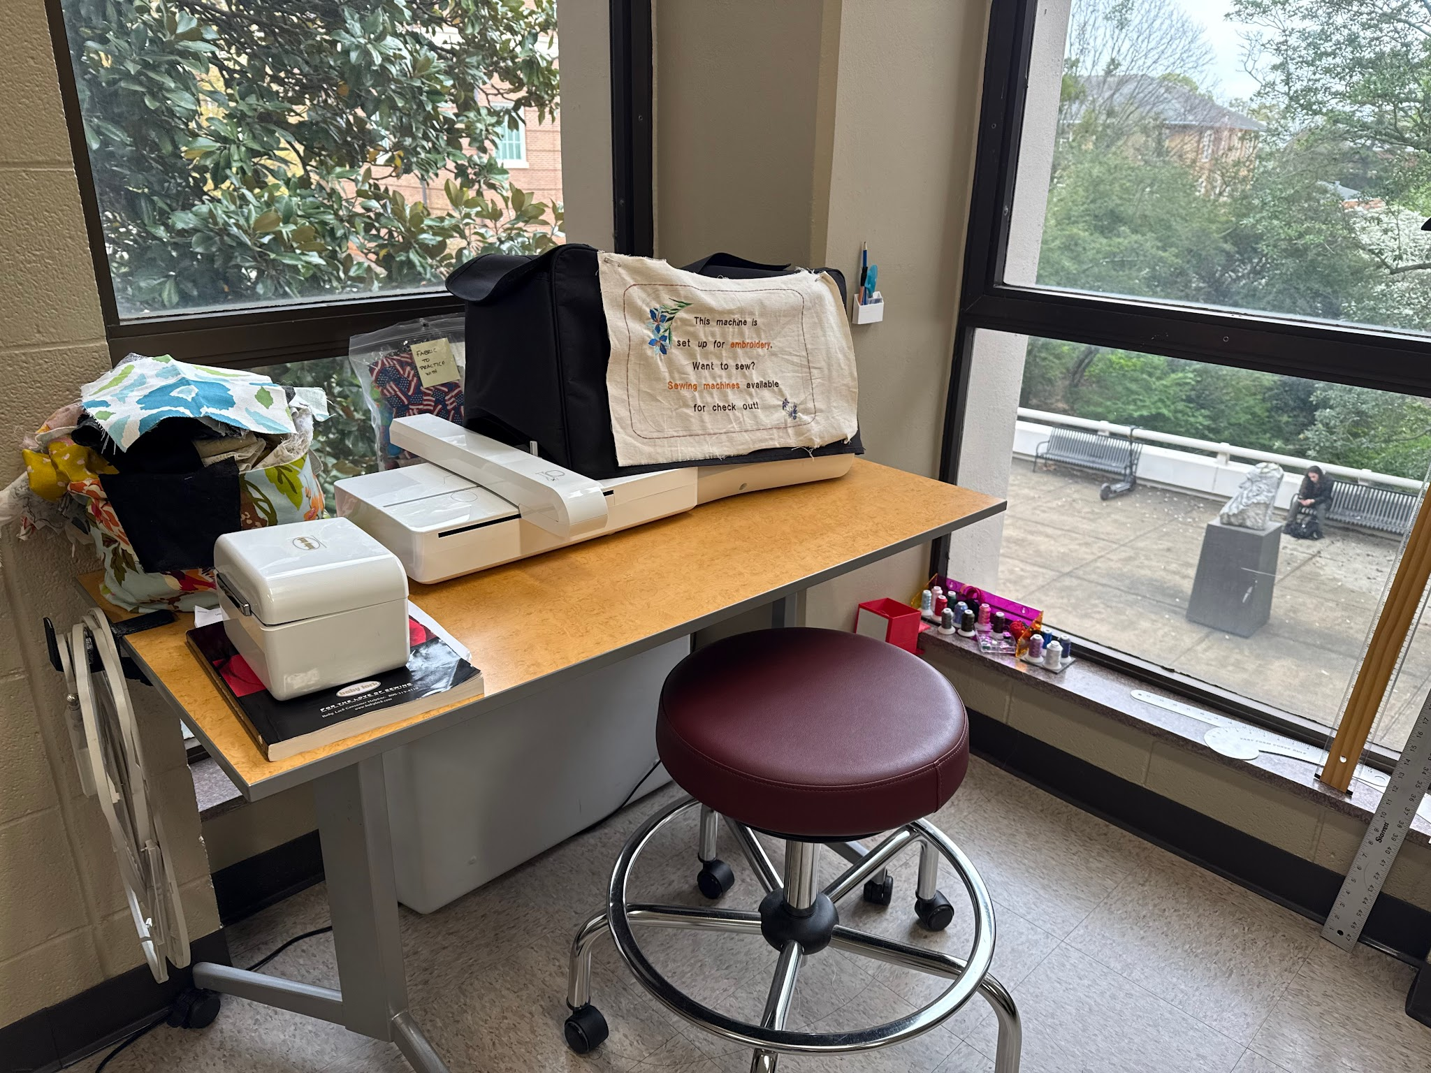
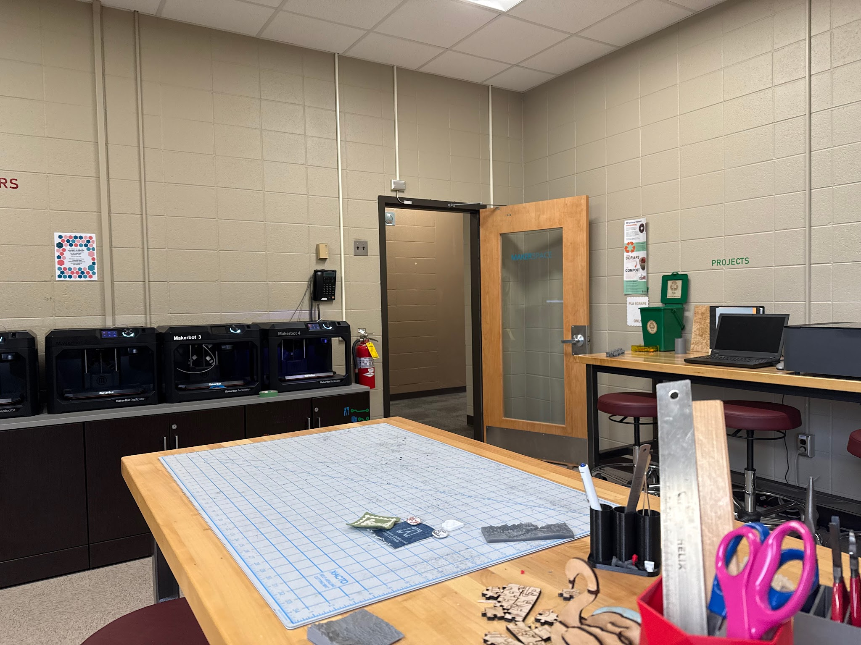
Photos of the UGA Makerspace

Slide 11

Interview Details
Held on March 17, 2025 at 6:00 pm on Microsoft Teams
Interviewed our Process Owner who is a student assistant at the Makerspace
Length: ~45 mins
We compiled our interview notes into a shared Google Document

Slide 12
Interview Outline
Introduction
Understanding the Organization's Value Chain
Business Process Mapping
Process inefficiencies or bottlenecks
Process Improvement
Closing

Slide 13
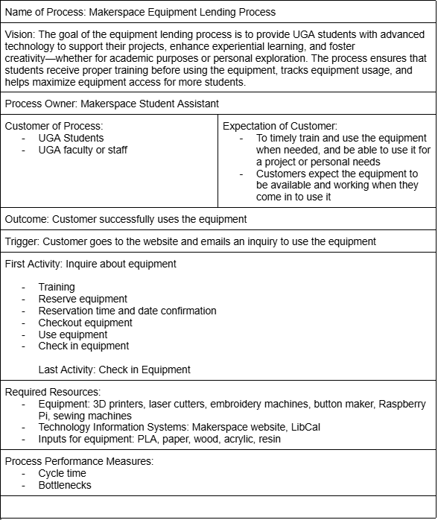
Process Profile of As-Is Process

Slide 14

As-Is Process Description
The equipment rental process is a straightforward process that begins with a customer inquiring about using equipment on the Makerspace website. If training is required the customer will go through training which involves training modules and signing up for in person training. The customer will then choose a time and date and complete the in person training. After the customer completes the required training they will then confirm a time and date to come in and use the equipment in the Makerspace. They will check out the equipment with a student assistant in the Makerspace and use the needed equipment until their project is completed. After they are done with the equipment they will check it back in with a student assistant. After the equipment is checked in they will receive a confirmation email and will then successfully have completed the Makerspace equipment rental process.

Slide 15
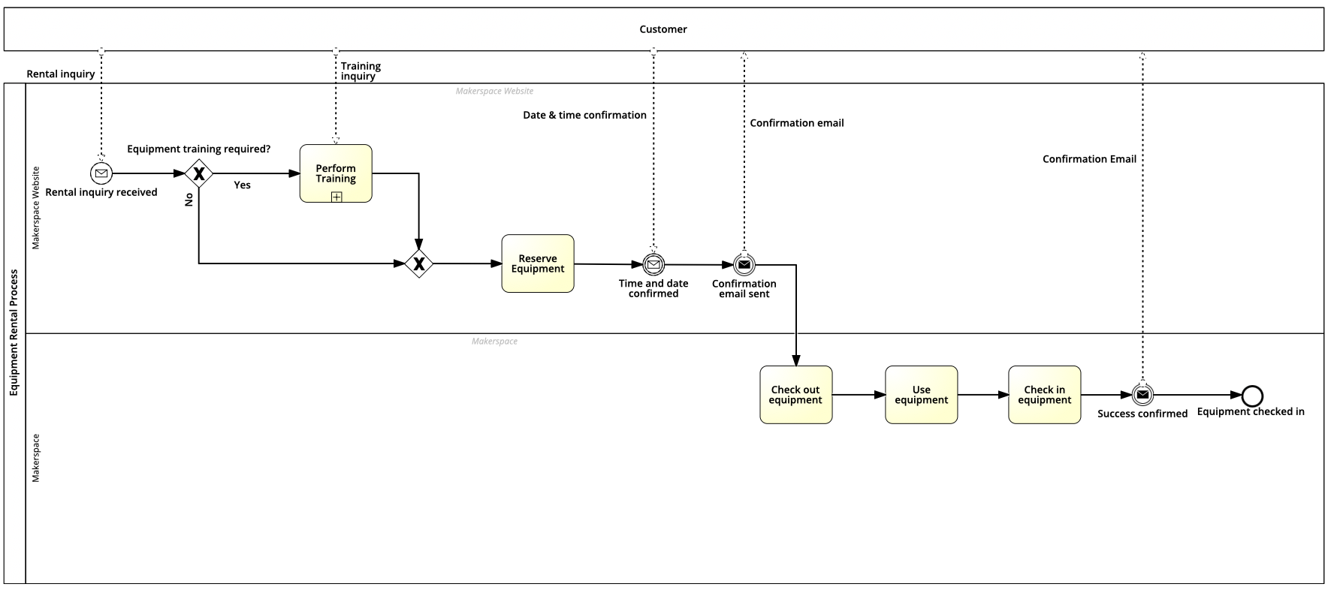
As-Is Diagram

Slide 16
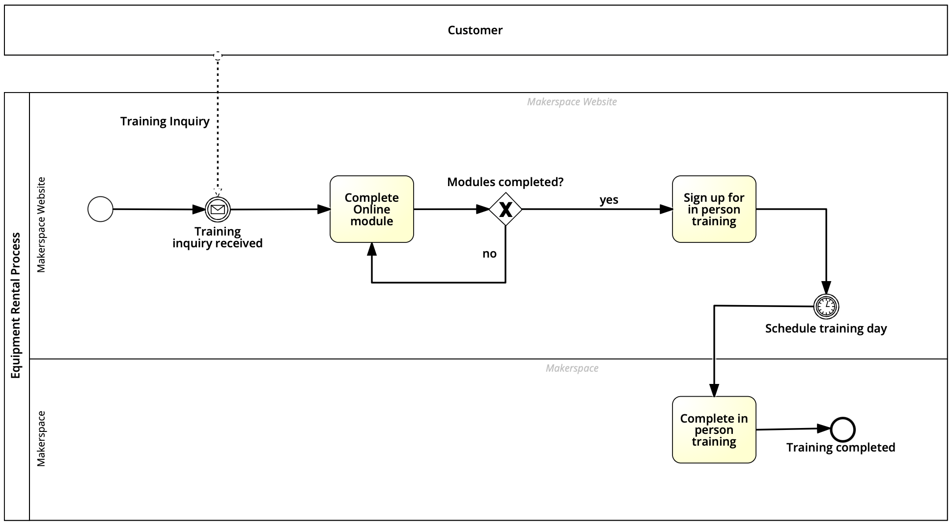
As-Is Diagram Training Sub-Process

Slide 17
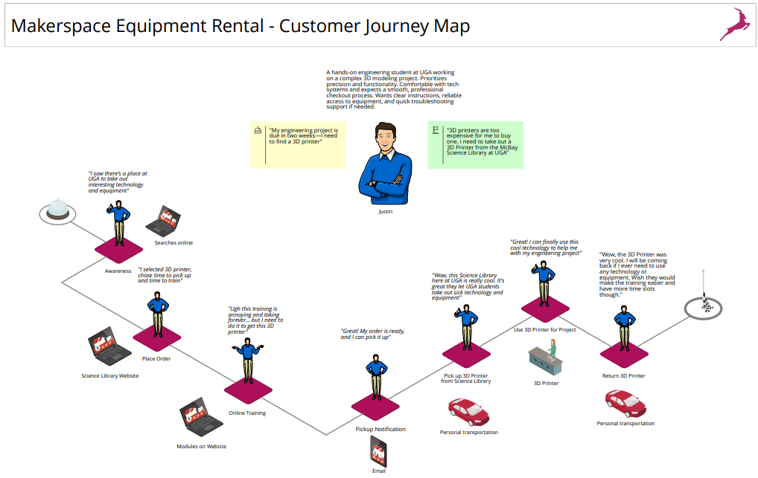
Customer Journey Map
Customer expresses annoyance with the lengthy training process

Slide 18
Process Analysis

Slide 19
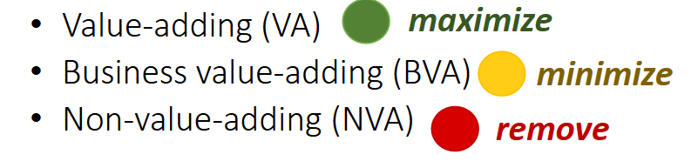
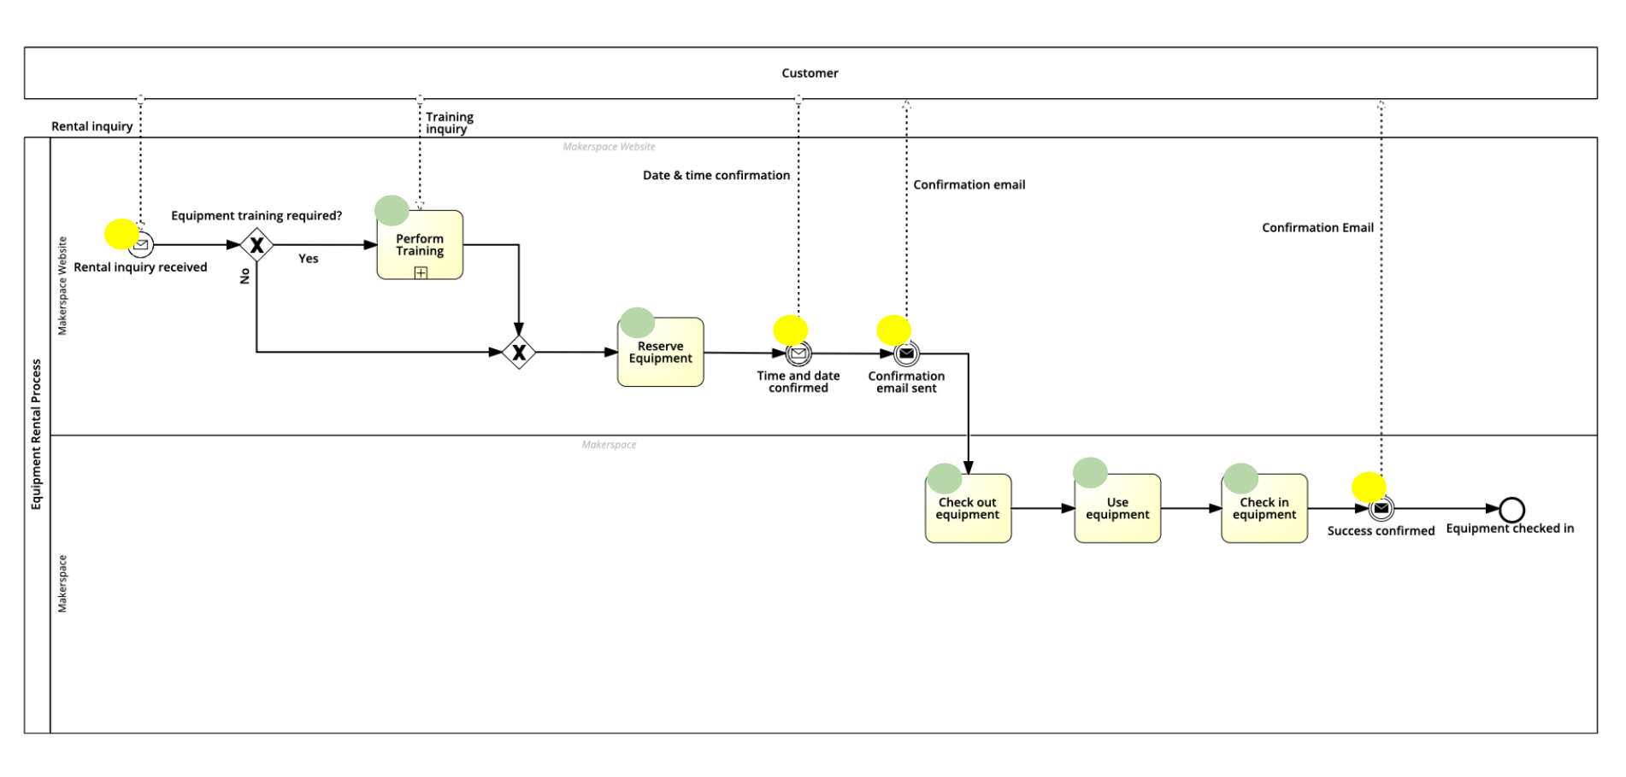
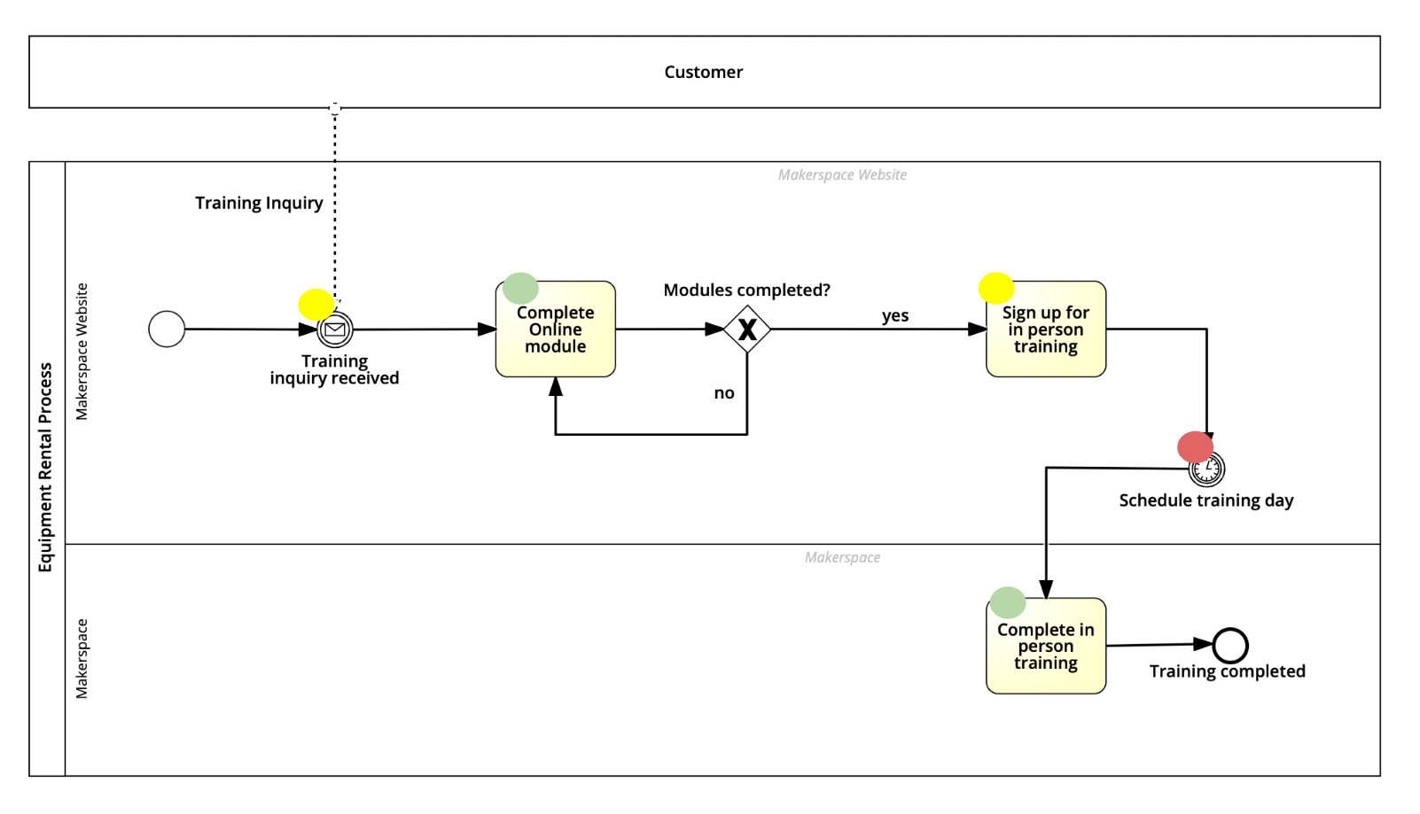
Qualitative Analysis
Value-adding analysis
Reserve equipment
Check out / check in equipment
Use equipment
Complete in-person training
Training- complete online module
Business value-adding
Rental inquiry
Training – sign up for in-person training
Time and date confirmed
Confirmation email sent\check in equipment
Equipment check-in confirmed
Non-value-adding
Wait for day of training

Slide 20
Quantitative Sub Process Analysis
120 mins (2 hours)
0 mins
95%
0 mins
5%
10080 mins (1 week)
45 mins
0+120/(1-.95)+0+10080+45
Processing time = 12525 mins

Slide 21
Quantitative Analysis
12525
0 mins
60%
2 mins
0 mins
0 mins
40%
0+12525(.60)+2+0+0+5+120+5+0
Processing time = 7647 mins
0 min
5 mins
2 hours
(120 mins)
5 mins

Slide 22
As-is Quantitative Analysis
Processing time
= 7647 mins
Cycle time (from process owner)
= 20160 mins (2 weeks)
Processing time / Cycle time = Cycle time efficiency
7647/20160 = 0.3794
= 37.94%

Slide 23

Process Analysis
What did we find?
We found the Training subprocess to be lengthy and inefficient in our current digital age. This was supported by non value adding activity of waiting for in person training and a low cycle time efficiency percentage

Slide 24
Our Findings
Within the training subprocess there is a non value adding activity that includes waiting time. Our solution will try to minimize or eliminate this waiting time for customers

Slide 25
Process Redesign

Slide 26
How can we make this more efficient?
Reduce waiting time by minimizing non value adding activities
This can be done by resequencing in person training, eliminating waiting time (training day)

Slide 27
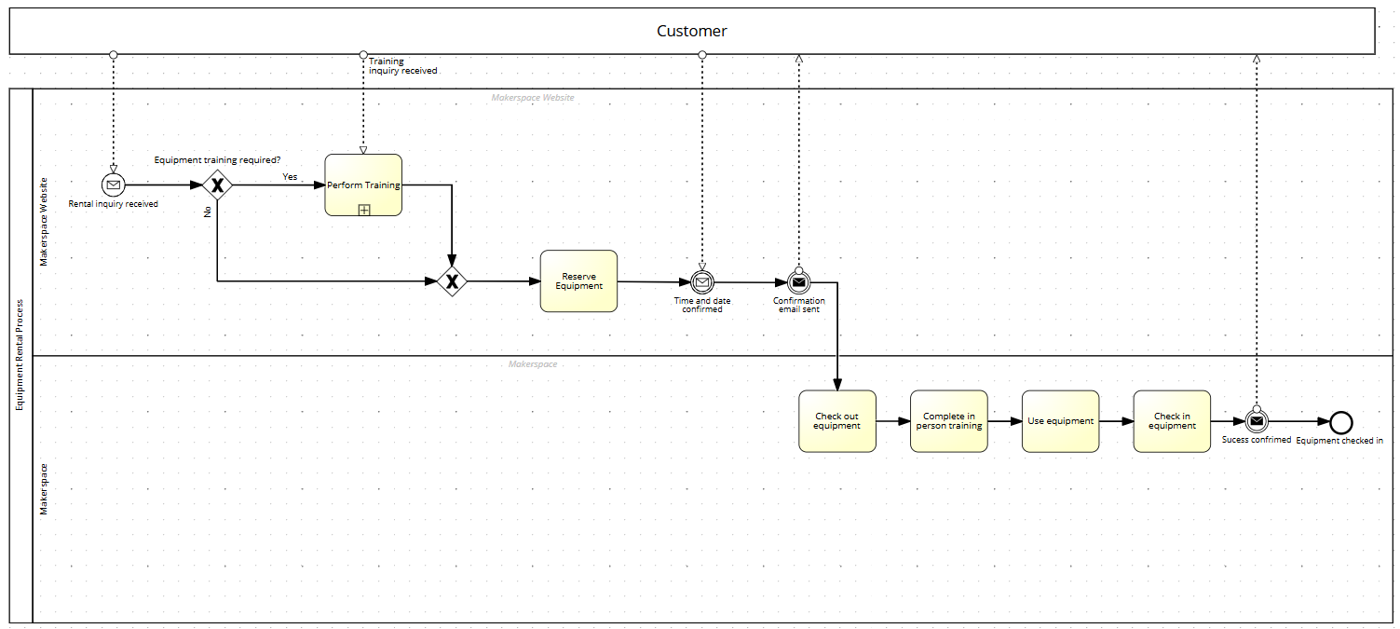
To-Be Model - Parent Process
Reduces waiting time by resequencing in person training to right before using equipment

Slide 28
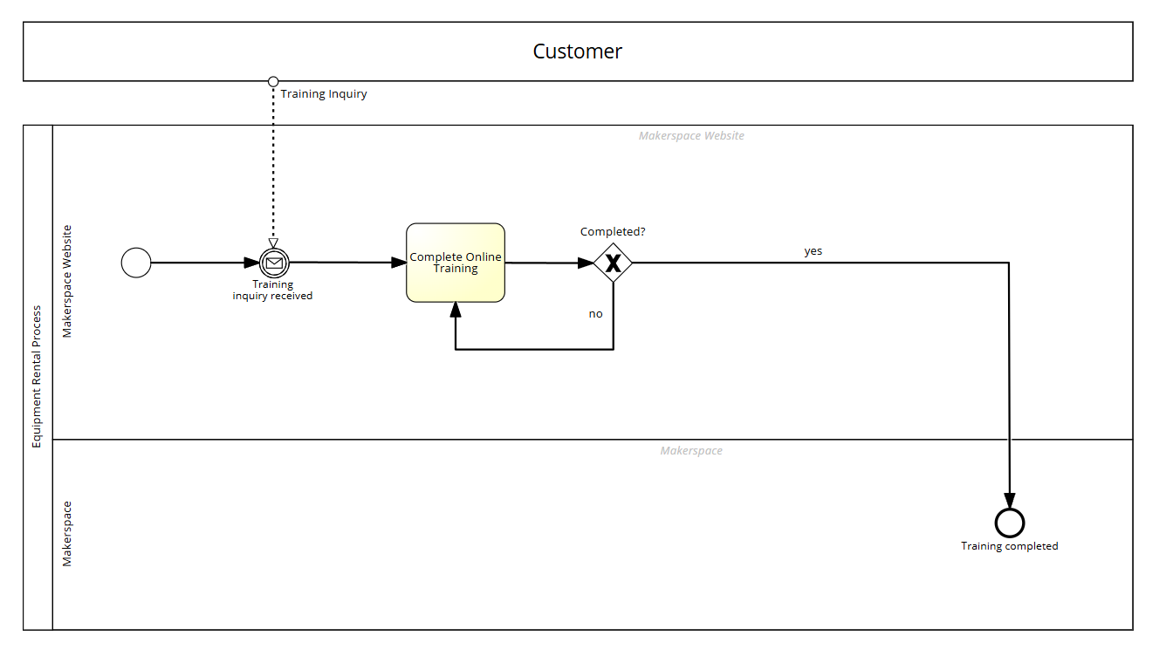
To-Be Model - Subprocesses
Reduces waiting time by resequencing in person training to the parent level

Slide 29
To-Be Model - Quantitative Analysis
2 hours (120 mins)
95%
0 mins
5%
0+120/(1-.95)
Processing time = 2400 mins

Slide 30
To-Be Model - Quantitative Analysis
2400 mins
60%
2 mins
0 mins
0 mins
40%
0 mins
5 mins
45 mins
0 mins
0+2400(.60)+2+0+0+5+45+120+5+0
Processing time = 1617 mins
120 mins
(2 hours)
5 mins

Slide 31
New Cycle Time Efficiency
Processing time
= 1617 mins
Cycle time (updated estimate from process owner with redesign)
= 2880 mins (2 days)
Processing time / Cycle time = Cycle time efficiency
1627/2880 = 0.5642
= 56.42%

Slide 32
Our Redesign
Takes Cycle Time Efficiency from:
37.94%
To:
56.42%
Huge improvement!!!

Slide 33

Communicating Redesign to Stakeholders
We will send our findings to our process owner via email
We will follow up any questions she might have on our improvements

